Slide 1

Best Practices For Starting a Podcast
Laura Lechner Valenzuela
Senior Associate Director, Creative Content
ll2963@gsb.columbia.edu

Slide 2
Content Creation
Why a podcast?
Who is your audience?
What is your message?
  Why is this message best suited for the podcast format?

Slide 3

Preparation
Research peer schools/institutions’ podcasts for inspiration
Consider the format
  Interview?
  Docuseries?
Pick a podcast hosting platform
  We host Bizcast on LibSyn
Develop release schedule
  Consistency is key!
How will you measure success?
  Podtrac
  Chartable

Slide 4
Production
Team roles and responsibilities
Pre-production
  Weekly team check-in
  Research
  Pre-interview
  Scheduling/location
Production
  Recording
Post-production
  Transcript
  Paper edit
  Audio edit

Slide 5
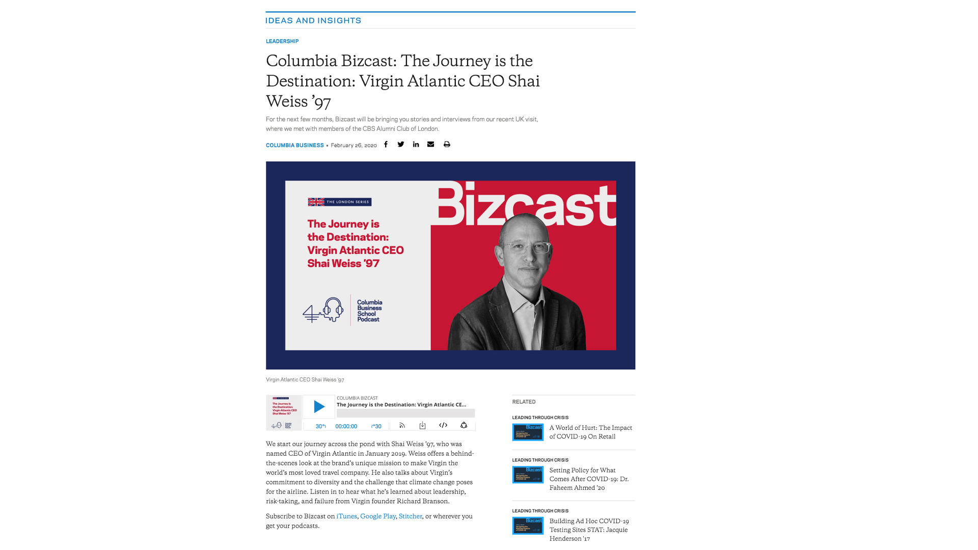
Production
Distribution
  Upload to LibSyn
  Create webpage
  Push out via channels

Slide 6
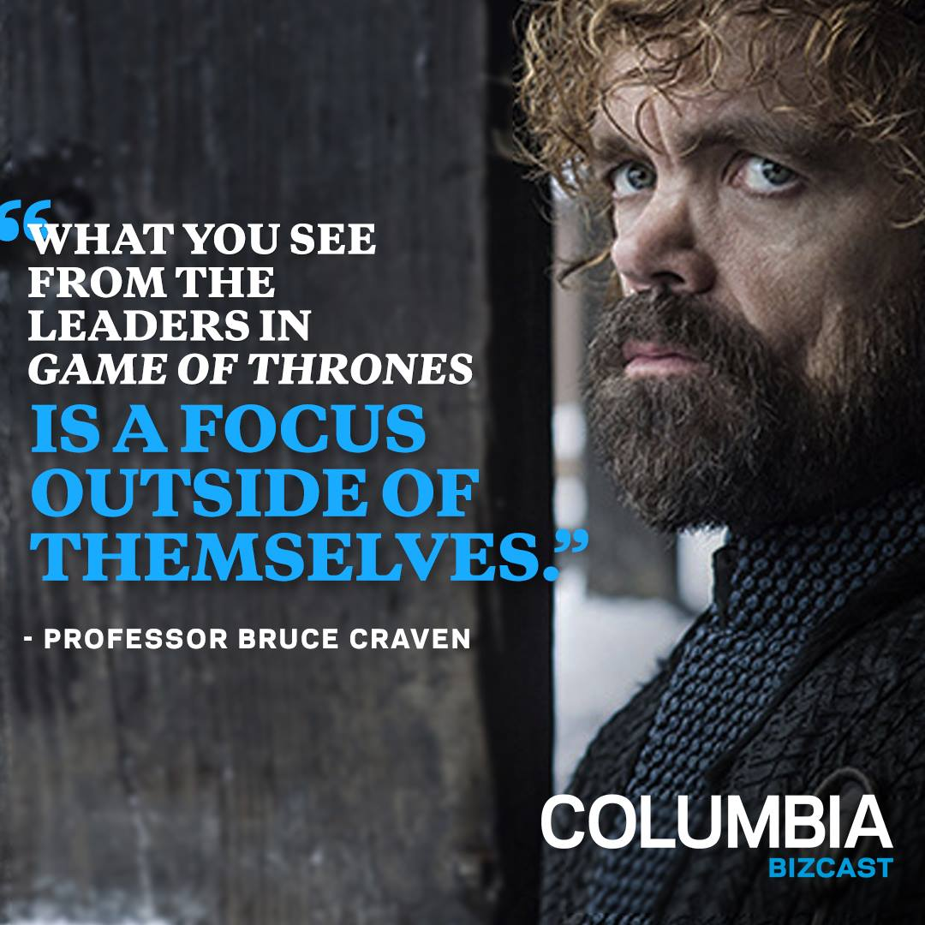
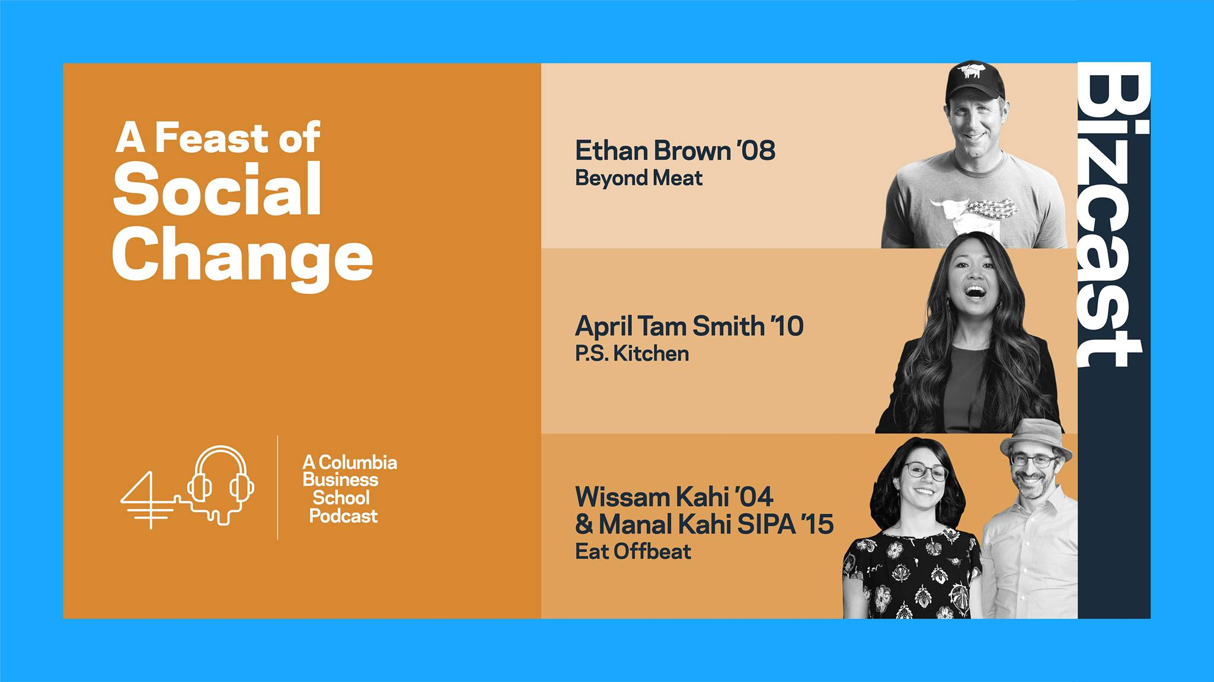
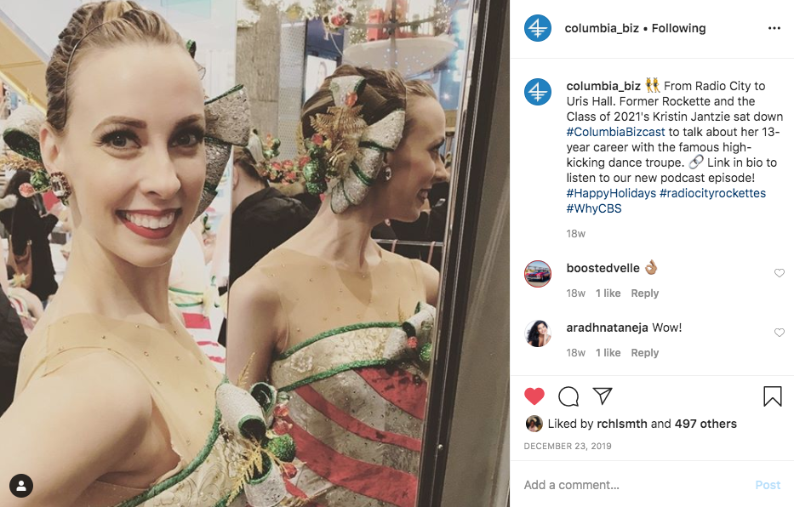
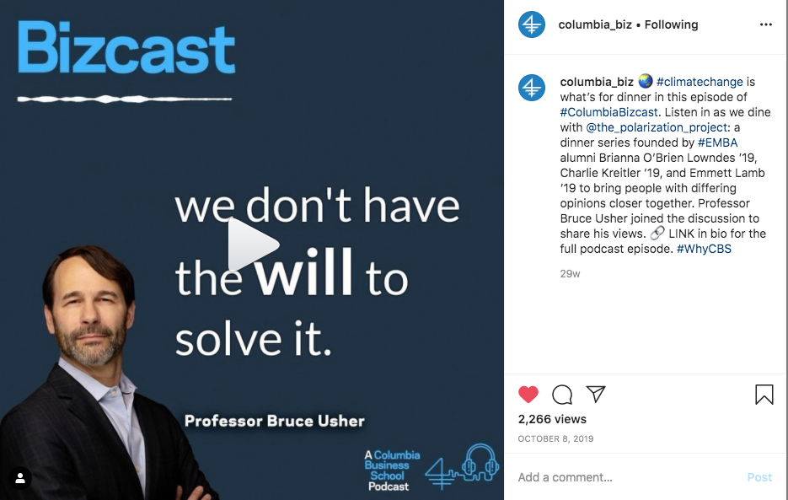
Building an Audience
Distribution channels
  Social media
  Newsletters/emails
  Student channels
Promo materials
  Audiograms
  Quote cards
  Photo carousels
  Cover image

Slide 7
Questions?
ll2963@gsb.columbia.edu

